Slide 1

Artificial Neural Networks (ANNs)
Pengantar Singkat Mengintip Kotak Hitam

Slide 2
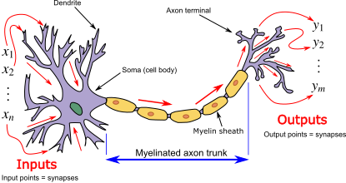
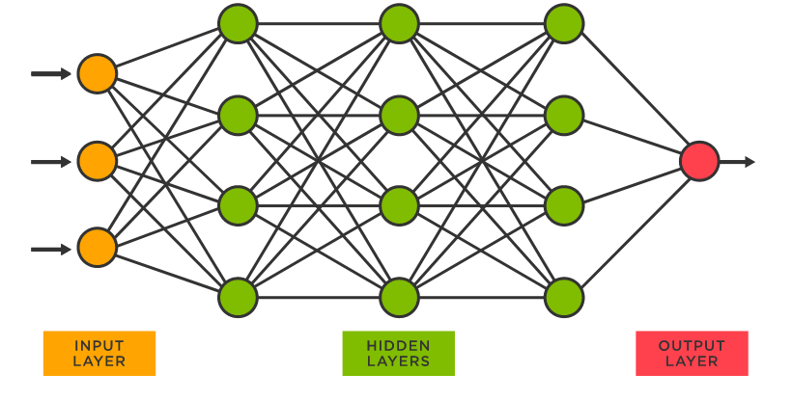
Latar Belakang
Mengadopsi kemampuan jaringan saraf manusia yang mampu menerima stimulasi/rangsangan, melakukan proses, dan memberikan output.
Pertama kali diperkenalkan oleh Warren McCulloch dan Walter Pitts untuk peningkatan komputasi. Selanjutnya dikembangkan oleh Rosenblatt (1950): two-layer network disebut perceptron.
nodes
Connection/edges

Slide 3
Simple Neural Networks
Activation function
Bias
Bobot
Input Layer
Output Layer
+ b₁
Hidden Layer
x w₃
x w₁
sum
+ b₃
=
x w₂
Input Layer
Output Layer
1 Input Layer (X)
1 Hidden Layer, 2 Neuron
1 Output Layer (Y)
x w₄
+ b₂
Hidden Layer

Slide 4

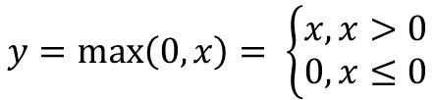

Activation Function
Rectified Linear Unit (ReLU)
$$y=\max\left(0, x\right)= \left\{\begin{matrix}x, x>0 \\ 0, x≤0\end{matrix}\right.$$
SoftPlus
$$y=ln⁡(1+ e^{x})$$
Sigmoid
$$y=\frac{1}{1+ e^{−x}}$$

Slide 5
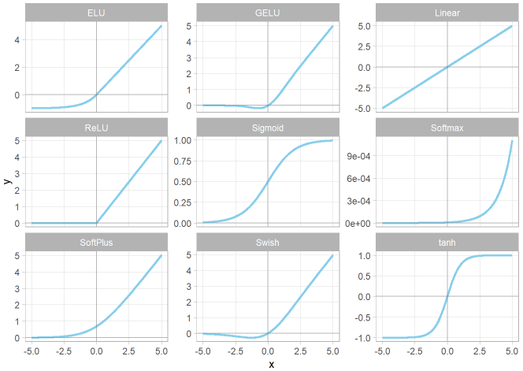







Activation Function
Regression — Linear/ReLU
Binary Classification — Sigmoid/Logistic/SoftPlus
Multiclass Classification — Softmax

Slide 6
Simple Neural Networks
Activation function
Bias
Bobot
+ b₁
Yes (1)
x w₃
x w₁
sum
+ b₃
=
x w₂
+ b₂
x w₄
No (0)
Usia [0,1]

Slide 7
Simple Neural Networks
Activation function
Bias
Bobot
+ ???
Yes (1)
x ???
x ???
sum
+ ???
=
x ???
+ ???
x ???
No (0)
Usia [0,1]
Membangun model pada Neural Networks berarti menentukan parameter bobot dan bias yang optimal

Slide 8
Simple Neural Networks
Activation function
Bias
Bobot
+ ???
Yes (1)
x ???
x ???
sum
+ ???
=
x ???
+ ???
x ???
No (0)
Usia [0,1]
Backpropagation!

Slide 9
Yes (1)
SoftPlus
Activation function
0 + (-1.43 ) = -1.43
~ 0.21455 x -1.22 =~ -0.26176
No (0)
0 x 3.34 = 0
Usia [0,1]
+ -1.43
x -1.22
x = -1.43
y =~ 0.21455
~ -0.26176 + ~ -2.34191 =
~ -2.60367
x 3.34
Usia
0
sum
+ 2.60
=
0
-1
x -3.53
x = 0.57
y =~ 1.01822
x -2.30
~ -2.60367 + 2.60 =
~ -0.004
+ 0.57
0 x -3.53 = 0
~ 1.01822 x -2.30 =~ -2.34191
-2
0 + 0.57 = 0.57

Slide 10
Yes (1)
SoftPlus
Activation function
3.34 + (-1.43 ) = 1.91
~ 2.04809 x -1.22 =~ -2.49867
No (0)
1 x 3.34 = 3.34
Usia [0,1]
+ -1.43
x -1.22
x = 1.91
y =~ 2.04809
~ -2.49867 + ~ -0.11620 =
~ -2.61487
x 3.34
Usia
1
sum
+ 2.60
=
0
-1
x -3.53
x = -2.96
y =~ 0.05052
x -2.30
~ -2.61487 + 2.60 =
~ -0.015
+ 0.57
1 x -3.53 = -3.53
~ 0.05052 x -2.30 =~ -0.11620
-2
-3.53 + 0.57 = -2.96

Slide 11
Yes (1)
SoftPlus
Activation function
1.67 + (-1.43 ) = 0.24
~ 0.82033 x -1.22 =~ -1.00080
No (0)
0.5 x 3.34 = 1.67
Usia [0,1]
+ -1.43
x -1.22
x = 0.24
y =~ 0.82033
~ -1.00080 + ~ -0.60822 =
~ -1.11700
x 3.34
Usia
0.5
sum
+ 2.60
=
1
-1
x -3.53
x = -1.195
y =~ 0.26444
x -2.30
~ -1.11700 + 2.60 =
~ 1.483
+ 0.57
0.5 x -3.53 = -1.765
~ 0.26444 x -2.30 =~ -0.60822
-2
-1.765 + 0.57 = -1.195

Slide 12
Yes (1)
SoftPlus
Activation function
No (0)
Usia [0,1]
+ -1.43
x -1.22
x 3.34
Usia
sum
+ 2.60
=
-1
x -3.53
+ 0.57
x -2.30
-2
Prediksi = biru + orange + b₃

Slide 13
Yes (1)
No (0)
Usia [0,1]
-1
-2

Slide 14
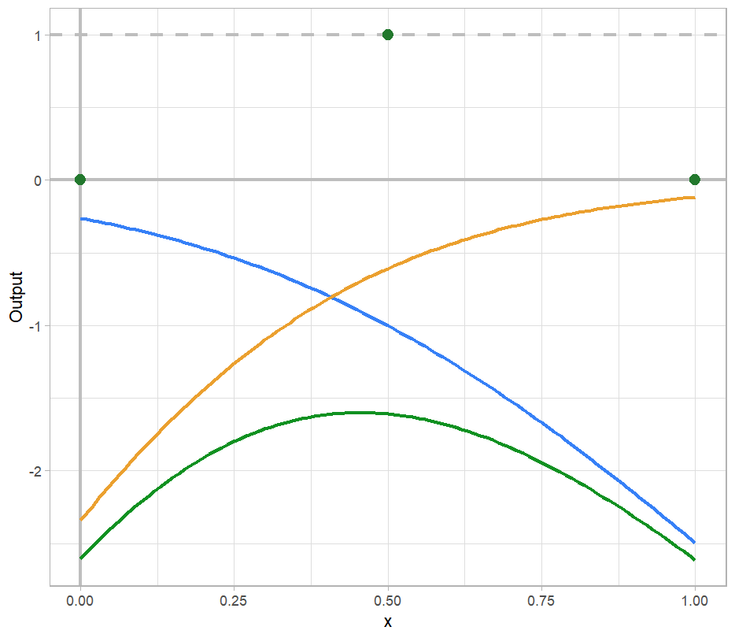
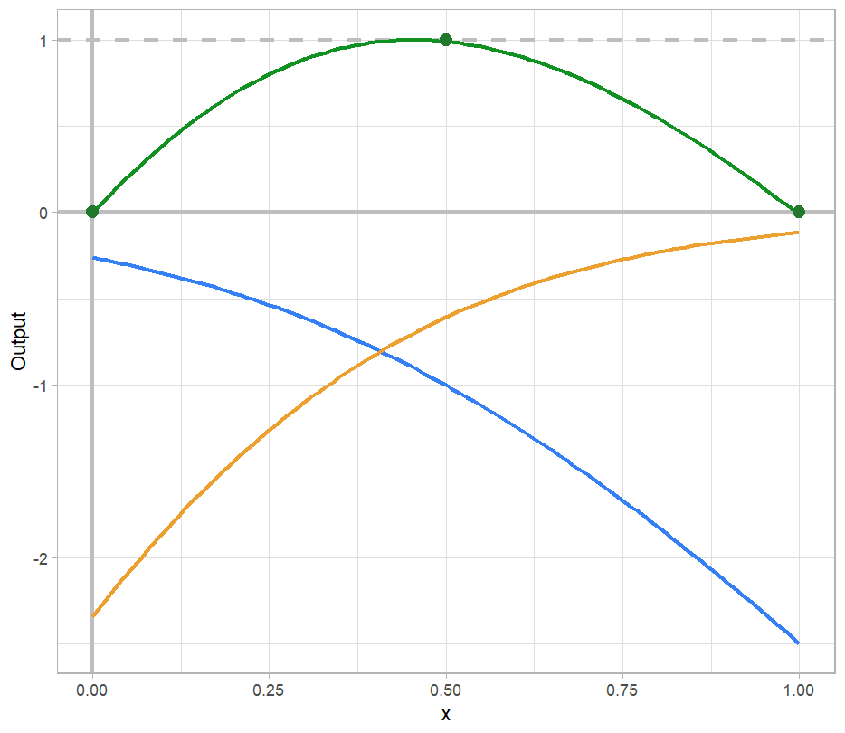
Bias
+ b₁
x w₃
x w₁
+ b₃
sum
=
x w₂
+ b₂
x w₄
b₃ = 0
b₃ = 2.60

Slide 15
Backpropagation
Yes (1)
No (0)
Usia [0,1]
+ -1.43
x -1.22
x 3.34
Usia
sum
+ 0.00
=
-1
x -3.53
+ 0.57
x -2.30
-2

Slide 16
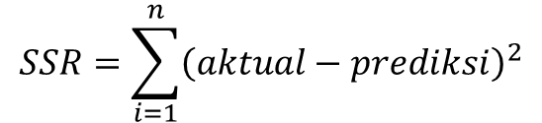
Backpropagation
b₃ = 0.00
Yes (1)
$$SSR=\sum_{i=1}^{n}{{\left(aktual−prediksi\right)}^{2}}$$
No (0)
Usia [0,1]
$$={\left(0−−2.60\right)}^{2}+{(0.5−−1.61)}^{2}+{\left(0−−2.61\right)}^{2}=20.38$$
SSR
-1
-2
b₃

Slide 17
Backpropagation
b₃ = 1.00
Yes (1)
$$SSR=\sum_{i=1}^{n}{{\left(aktual−prediksi\right)}^{2}}$$
No (0)
Usia [0,1]
$$={\left(0−−1.60\right)}^{2}+{(0.5−−0.61)}^{2}+{\left(0−−1.61\right)}^{2}=7.77$$
SSR
-1
-2
b₃

Slide 18
Backpropagation
b₃ = 2.00
Yes (1)
$$SSR=\sum_{i=1}^{n}{{\left(aktual−prediksi\right)}^{2}}$$
No (0)
Usia [0,1]
$$={\left(0−−0.60\right)}^{2}+{(0.5−0.39)}^{2}+{\left(0−−0.61\right)}^{2}=1.11$$
SSR
-1
-2
b₃

Slide 19
Backpropagation
b₃ = 3.00
Yes (1)
$$SSR=\sum_{i=1}^{n}{{\left(aktual−prediksi\right)}^{2}}$$
No (0)
Usia [0,1]
$$={\left(0−0.40\right)}^{2}+{(0.5−1.39)}^{2}+{\left(0−0.39\right)}^{2}=0.46$$
SSR
-1
-2
b₃

Slide 20
Backpropagation
Yes (1)
SSR
No (0)
Usia [0,1]
-1
b₃
-2
Optimal b₃ agar SSR minimum

Slide 21
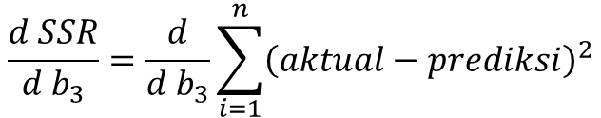
Backpropagation
Yes (1)
SSR
No (0)
Usia [0,1]
-1
b₃
-2
Untuk mendapatkan nilai minimum dari kurva SSR lebih cepat menggunakan Gradient Decent
Turunan SSR terhadap b₃
$$\frac{d SSR}{d b_{3}}=\frac{d}{d b_{3}}\sum_{i=1}^{n}{{\left(aktual−prediksi\right)}^{2}}$$

Slide 22

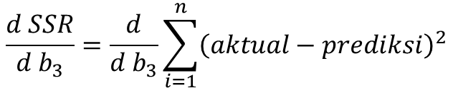
Gradient Decent
Yes (1)
$$\frac{d SSR}{d b_{3}}=\frac{d}{d b_{3}}\sum_{i=1}^{n}{{\left(aktual−prediksi\right)}^{2}}$$
No (0)
Usia [0,1]
prediksi = biru + orange + b₃
-1
Karena SSR terhubung dengan b₃ melalui prediksi, maka dapat menggunakan Aturan Rantai (Chain Rule)
$$\frac{d SSR}{d b_{3}}=\frac{d SSR}{d prediksi }×\frac{d prediksi}{d b_{3}}$$
-2

Slide 23
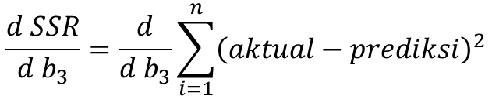

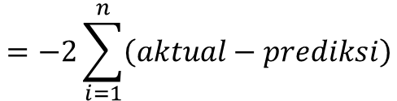
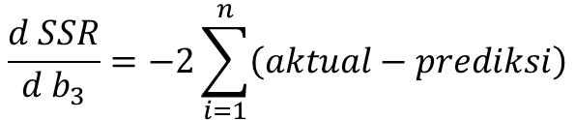

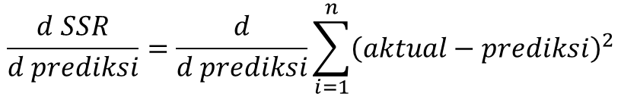
Gradient decent
$$\frac{d SSR}{d b_{3}}=\frac{d}{d b_{3}}\sum_{i=1}^{n}{{\left(aktual−prediksi\right)}^{2}}$$
$$\frac{d SSR}{d b_{3}}=\frac{d SSR}{d prediksi }×\frac{d prediksi}{d b_{3}}$$
$$\frac{d SSR}{d prediksi}=\frac{d}{d prediksi}\sum_{i=1}^{n}{{\left(aktual−prediksi\right)}^{2}}$$
$$\frac{d SSR}{d b_{3}}=−2\sum_{i=1}^{n}{\left(aktual−prediksi\right)}$$
$$=−2\sum_{i=1}^{n}{\left(aktual−prediksi\right)}$$
$$\frac{d prediksi}{d b_{3}}=\frac{d}{d b_{3}}$$
(biru + orange + b₃) = 0 + 0 + 1

Slide 24
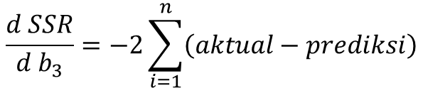
Backpropagation
b₃=0
Yes (1)
$$\frac{d SSR}{d b_{3}}=−2\sum_{i=1}^{n}{\left(aktual−prediksi\right)}$$
No (0)
Usia [0,1]
= -2[(0 – (-2.60)) + (0.5 – (-1.6)) + (1 – (-2.61))]
= -15.66
SSR
-1
-2
b₃

Slide 25

Backpropagation
b₃=0
Yes (1)
$$\frac{d SSR}{d b_{3}}=−2\sum_{i=1}^{n}{\left(aktual−prediksi\right)}$$
No (0)
Usia [0,1]
= -2[(0 – (-2.60)) + (0.5 – (-1.6)) + (1 – (-2.61))]
= -15.66
$$\frac{d SSR}{d b_{3}}$$
SSR
-1
step size = X Learn Rate
= -15.66 X 0.1= -1.566
-2
b₃* = b₃ – step size
= 0 – (-1.566) = 1.566
Learn Rate: menentukan besarnya perubahan parameter
b₃

Slide 26
Backpropagation
b₃= 1.566
Yes (1)
$$\frac{d SSR}{d b_{3}}=−2\sum_{i=1}^{n}{\left(aktual−prediksi\right)}$$
No (0)
Usia [0,1]
= -2[(0 – (-1.04) + (0.5 – (-0.04)) + (1 – (-1.05))]
= -6.26
SSR
-1
-2
b₃
SSR = 3.265

Slide 27
Backpropagation
b₃= 1.566
Yes (1)
$$\frac{d SSR}{d b_{3}}=−2\sum_{i=1}^{n}{\left(aktual−prediksi\right)}$$
No (0)
Usia [0,1]
= -2[(0 – (-1.04) + (0.5 – (-0.04)) + (1 – (-1.05))]
= -6.26
$$\frac{d SSR}{d b_{3}}$$
SSR
-1
step size = X Learn Rate
= -6.26 X 0.1= -0. 626
-2
b₃* = b₃ – step size
= 1.566 – (-0.626) = 2.192
b₃
SSR = 3.265

Slide 28
Backpropagation
b₃= 2.192
Yes (1)
$$\frac{d SSR}{d b_{3}}=−2\sum_{i=1}^{n}{\left(aktual−prediksi\right)}$$
No (0)
Usia [0,1]
= -2[(0 – (-0.41) + (0.5 – (0.58)) + (1 – (-0.42))]
= -2.50
-1
-2
SSR = 0.522

Slide 29
Backpropagation
b₃= 2.192
Yes (1)
$$\frac{d SSR}{d b_{3}}=−2\sum_{i=1}^{n}{\left(aktual−prediksi\right)}$$
No (0)
Usia [0,1]
= -2[(0 – (-0.41) + (0.5 – (0.58)) + (1 – (-0.42))]
= -2.50
$$\frac{d SSR}{d b_{3}}$$
-1
step size = X Learn Rate
= -2.50 X 0.1= -0.250
-2
b₃* = b₃ – step size
= 2.192 – (-0.250) = 2.442
SSR = 0.522

Slide 30
Backpropagation
b₃= 2.442
Yes (1)
$$\frac{d SSR}{d b_{3}}=−2\sum_{i=1}^{n}{\left(aktual−prediksi\right)}$$
No (0)
Usia [0,1]
= -2[(0 – (-0.16) + (0.5 – (0.83)) + (1 – (-0.17))]
= -1.00
-1
-2
SSR = 0.084

Slide 31
Backpropagation
b₃= 2.442
Yes (1)
$$\frac{d SSR}{d b_{3}}=−2\sum_{i=1}^{n}{\left(aktual−prediksi\right)}$$
No (0)
Usia [0,1]
= -2[(0 – (-0.16) + (0.5 – (0.83)) + (1 – (-0.17))]
= -1.00
$$\frac{d SSR}{d b_{3}}$$
-1
step size = X Learn Rate
= -1.00 X 0.1= -0.100
-2
b₃* = b₃ – step size
= 2.442 – (-0.100) = 2.542
SSR = 0.084

Slide 32
Backpropagation
b₃= 2.542
Yes (1)
$$\frac{d SSR}{d b_{3}}=−2\sum_{i=1}^{n}{\left(aktual−prediksi\right)}$$
No (0)
Usia [0,1]
= -2[(0 – (-0.06) + (0.5 – (0.93)) + (1 – (-0.07))]
= -0.40
-1
-2
SSR = 0.014

Slide 33
Backpropagation
b₃= 2.542
Yes (1)
$$\frac{d SSR}{d b_{3}}=−2\sum_{i=1}^{n}{\left(aktual−prediksi\right)}$$
No (0)
Usia [0,1]
= -2[(0 – (-0.06) + (0.5 – (0.93)) + (1 – (-0.07))]
= -0.40
$$\frac{d SSR}{d b_{3}}$$
-1
step size = X Learn Rate
= -0.40 X 0.1= -0.040
-2
b₃* = b₃ – step size
= 2.542 – (-0.040) = 2.582
SSR = 0.014

Slide 34
Backpropagation
b₃= 2.582
Yes (1)
$$\frac{d SSR}{d b_{3}}=−2\sum_{i=1}^{n}{\left(aktual−prediksi\right)}$$
No (0)
Usia [0,1]
= -2[(0 – (-0.02) + (0.5 – (0.97) + (1 – (-0.03))]
= -0.16
-1
-2
SSR = 0.002

Slide 35
Backpropagation
b₃= 2.582
Yes (1)
$$\frac{d SSR}{d b_{3}}=−2\sum_{i=1}^{n}{\left(aktual−prediksi\right)}$$
No (0)
Usia [0,1]
= -2[(0 – (-0.02) + (0.5 – (0.97) + (1 – (-0.03))]
= -0.16
$$\frac{d SSR}{d b_{3}}$$
-1
step size = X Learn Rate
= -0.16 X 0.1= -0.016
-2
b₃* = b₃ – step size
= 2.582 – (-0.016) = 2.598
SSR = 0.002

Slide 36
Backpropagation
b₃= 2.598
Yes (1)
$$\frac{d SSR}{d b_{3}}=−2\sum_{i=1}^{n}{\left(aktual−prediksi\right)}$$
No (0)
Usia [0,1]
= -2[(0 – (-0.01) + (0.5 – (0.99) + (1 – (-0.02))]
= -0.07
-1
-2
SSR = 0.0004

Slide 37
Backpropagation
b₃= 2.598
Yes (1)
$$\frac{d SSR}{d b_{3}}=−2\sum_{i=1}^{n}{\left(aktual−prediksi\right)}$$
No (0)
Usia [0,1]
= -2[(0 – (-0.01) + (0.5 – (0.99) + (1 – (-0.02))]
= -0.07
$$\frac{d SSR}{d b_{3}}$$
-1
step size = X Learn Rate
= -0.07 X 0.1= -0.007
-2
b₃* = b₃ – step size
= 2.598 – (-0.007) = 2.605
SSR = 0.0004

Slide 38
Backpropagation
b₃= 2.605
Yes (1)
$$\frac{d SSR}{d b_{3}}=−2\sum_{i=1}^{n}{\left(aktual−prediksi\right)}$$
No (0)
Usia [0,1]
= -2[(0 – (0.001) + (0.5 – (0.996) + (1 – (-0.001))]
= -0.03
-1
-2
SSR = 0.0000

Slide 39
Backpropagation
b₃= 2.605
Yes (1)
$$\frac{d SSR}{d b_{3}}=−2\sum_{i=1}^{n}{\left(aktual−prediksi\right)}$$
No (0)
Usia [0,1]
= -2[(0 – (0.001) + (0.5 – (0.996) + (1 – (-0.001))]
= -0.03
$$\frac{d SSR}{d b_{3}}$$
-1
step size = X Learn Rate
= -0.03 X 0.1= -0.003
-2
b₃* = b₃ – step size
= 2.605 – (-0.003) = 2.608
SSR = 0.0000

Slide 40
Backpropagation
b₃= 2.605
Yes (1)
No (0)
Usia [0,1]
+ -1.43
x -1.22
x 3.34
Usia
sum
+ 2.605
=
-1
x -3.53
+ 0.57
x -2.30
-2

Slide 41
x₁ = input x w₁ + b₁
y₁ = f(x₁) = ln(1 + e^{x1})
biru = y₁ x w₃
+ b₁
x w₃
x w₁
Usia
sum
+ b₃
=
x w₂
+ b₂
x w₄
orange = y₂ x w₄
x₂ = input x w₂ + b₂
y₂ = f(x₂) = ln(1 + e^{x2})

Slide 42
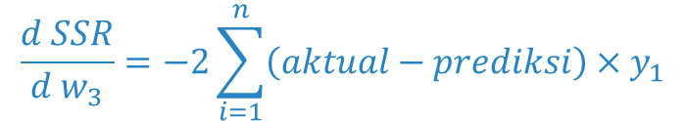
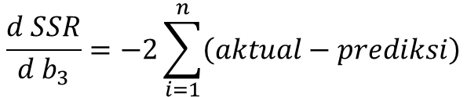


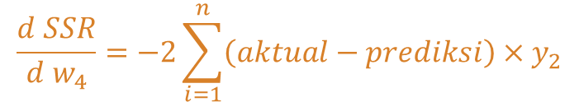
prediksi = biru + orange + b₃
$$\frac{d SSR}{d b_{3}}=−2\sum_{i=1}^{n}{\left(aktual−prediksi\right)}$$
prediksi = y₁w₃ + y₂w₄ + b₃
$$\frac{d SSR}{d w_{3}}=\frac{d SSR}{d prediksi}×\frac{d prediksi}{d w_{3}}$$
$$\frac{d SSR}{d w_{4}}=\frac{d SSR}{d prediksi}×\frac{d prediksi}{d w_{4}}$$
$$\frac{d SSR}{d w_{3}}=−2\sum_{i=1}^{n}{\left(aktual−prediksi\right)}×y_{1}$$
$$\frac{d SSR}{d w_{4}}=−2\sum_{i=1}^{n}{\left(aktual−prediksi\right)}×y_{2}$$

Slide 43

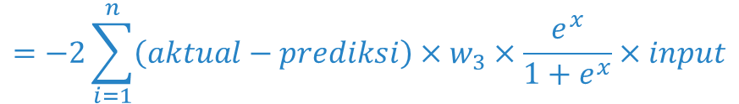
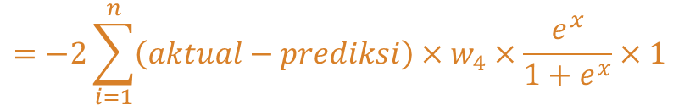


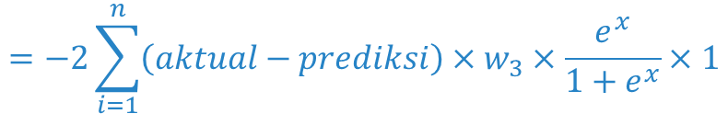

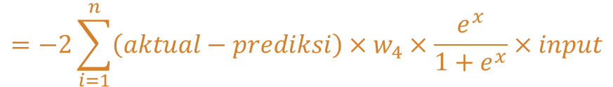
prediksi = y₁w₃ + y₂w₄ + b₃
x₁ = input x w₁ + b₁
y₁ = f(x₁) = ln(1 + e^{x1})
x₂ = input x w₂ + b₂
y₂ = f(x₂) = ln(1 + e^{x2})
$$\frac{d SSR}{d w_{1}}=\frac{d SSR}{d prediksi}×\frac{d prediksi}{d y_{1}}×\frac{d y_{1}}{d x_{1}}×\frac{d x_{1}}{d w_{1}}$$
$$\frac{d SSR}{d w_{2}}=\frac{d SSR}{d prediksi}×\frac{d prediksi}{d y_{2}}×\frac{d y_{2}}{d x_{2}}×\frac{d x_{2}}{d w_{2}}$$
$$=−2\sum_{i=1}^{n}{\left(aktual−prediksi\right)}×w_{3}×\frac{e^{x}}{1+e^{x}}×input$$
$$=−2\sum_{i=1}^{n}{\left(aktual−prediksi\right)}×w_{4}×\frac{e^{x}}{1+e^{x}}×input$$
$$\frac{d SSR}{d b_{1}}=\frac{d SSR}{d prediksi}×\frac{d prediksi}{d y_{1}}×\frac{d y_{1}}{d x_{1}}×\frac{d x_{1}}{d b_{1}}$$
$$\frac{d SSR}{d b_{2}}=\frac{d SSR}{d prediksi}×\frac{d prediksi}{d y_{2}}×\frac{d y_{2}}{d x_{2}}×\frac{d x_{2}}{d b_{2}}$$
$$=−2\sum_{i=1}^{n}{\left(aktual−prediksi\right)}×w_{3}×\frac{e^{x}}{1+e^{x}}×1$$
$$=−2\sum_{i=1}^{n}{\left(aktual−prediksi\right)}×w_{4}×\frac{e^{x}}{1+e^{x}}×1$$

Slide 44
Nilai awal bias biasanya 0
Nilai awal bobot salah satu caranya dengan mengambil nilai acak dari sebaran N(0,1)
X
X
X
X
+ b₁
x w₃
x w₁
sum
+ b₃
=
x w₂
+ b₂
x w₄

Slide 45
Multivariate INput
X1
x w₁
sum
+ b₁
x w₂
x w₃
sum
+ b₃
=
x w₁
x w₄
X2
x w₂
sum
+ b₂

Slide 46
Multi-class output
X1
x w₁
sum
+ b₁
x w₃
sum
+ b₃
=
x w₂
x w₅
x w₁
x w₄
X2
x w₂
sum
+ b₂
sum
+ b₄
=
x w₆

Slide 47
Multiple hidden layer
X1
x w₁
sum
+ b₁
x w₅
+ b₃
sum
x w₃
x w₉
x w₇
sum
+ b₅
=
x w₂
x w₆
x w₁₀
X2
x w₄
sum
+ b₂
sum
+ b₄
x w₈
Input Layer
Hidden Layer
Output Layer

